Slide 1
Communication Plan
Project
„MONA LIZA“

Slide 2
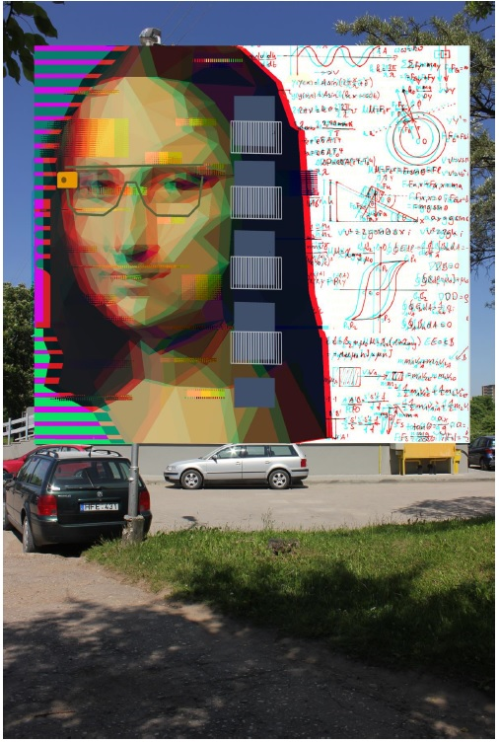
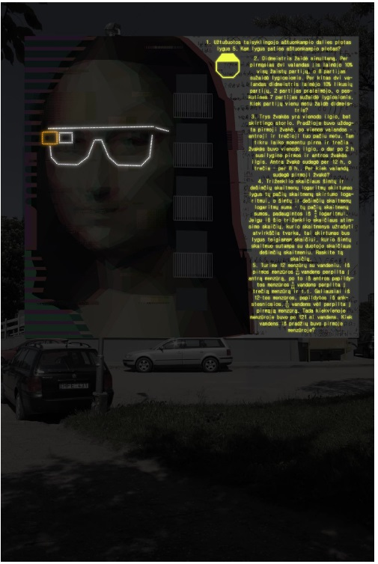
The idea

Slide 3
The idea
„Mona Liza“
Object: graffiti painting
Location: Studentų str. 71, the side wall of a dormitory.
Project „Mona Liza: Dadaism in the XX" – showcase the universities interdisciplinary modules thought art and technology.
This project will honor the famous artist and inventor Da Vinci. This is the second painting influenced by the artist in KTU. The first one is in the humanities buildings backyard. (A.Mickevičiaus str. 37)

Slide 4
The idea
About the project:
Kaunas university of technology – is innovative, advanced, focused towards the future.
The Universities community is young, progressive, creating new projects with their ideas.
The symbol of Da Vinci and his famous painting Mona Liza reflects the artists ability to exceed time.
Da Vinci is known for being an entrepreneur to all of the many inventions, theories and ideas we use and know today that are interdisciplinary.

Slide 5
The idea
The aim of the project:
- Develop the Universities positive image to its TG (target groups)
- Promote innovative initiatives that „exceed its time“ and show these initiatives being developed in the University.
- Cultivate the interest in new technologies in the learning process, provoke social and economical interest in the University through the projects communication.

Slide 6
The idea
Main elements to focus on in the Project:
The 3D idea of the painting – it is unique, and is being done the first time.
The interactive features of the project – the glasses that light up when they are turned on in the paintings web site.
The mathematical problem – the aim is to solve the problem, that is seen partially in the day and partially in the night. By solving the problem you get an answer that is the code that turns on the glasses. The Continent of the problem – why it is interesting and challenging?
The painting „coming to life“ – with the help of 3D glasses the painting comes to life.

Slide 7
The assignment
Assignment:
Prepare a communication plan for the Project
Aims for your plan:
To inform your TG about the project.
To form a positive image about the University.
To encourage and promote TG to visit the painting
(location, website, etc.).

Slide 8
The assignment
Pick your TG (target group):
Citizens of Kaunas city
Visitors from abroad
University Students (from Kaunas city)
High/primary Scholl students (from Lithuania)
In your communication plan you should point out:
The way of communication that you have picked – it can be focused on commercials, social media, non traditional marketing ideas and so on. It can be texts, videos, gifs or anything else that you think of. Do not limit yourselves with only one channel or idea.
Your communication channels – plan specific channels that you will use to promote your idea, that will help you to get your message across.
Describe your communication medium in detaill focusing on the content. Describe each content in relevance to your channels. Your content should be prepared based on your TG – depending on your target groups interests, wants, likes, behavior and so on.

Slide 9
The assignment
Target group
Content
Way of communication
Channels

Slide 10
The assignment
Target group
Pick your target group
Target groups or a target audience is the intended audience or readership of a publication, advertisement, or other message.
Example: students, who live in Kaunas; high school students, who live near Kaunas; tourists ect.

Slide 11
The assignment
Way of communication
2. Pick a medium
This way of communication will show how you will get your message and idea across to the Target group.
Example: a shoet video clip; a poster; a GIF ect,.

Slide 12
The assignment
Content
3. Pick your content
you can offer a unique, entertaining, or immersive experience that helps target groups forge a positive, memorable association with your project and what it stands for.
Example:
An interview with the painter; “the making of” style GIF series ect,.

Slide 13
The assignment
Channels
4. Choose your channels
This is a specific medium used in reaching intended audience, such as newspapers, radio stations, television stations, etc. You should pick the communication channel (the media) that makes the most sense for your particular target audience.
Example:
You would not target a newspaper to teens, you should rather pick social media.

Slide 14

Neringa Kirijenkaitė I Marketing Projects Manager
Marketing and Communications I Marketing dept.
K. Donelaičio g. 73,114 kab., LT-44029 Kaunas
+370 37 300 690 | +370 67271348
neringa.kirijenkaite@ktu.lt
ktu.edu

